Slide 1

Predicting Customer Churn in Telecom
Addressing high customer churn is crucial for maintaining revenue and fostering growth within our telecom division. This presentation outlines a strategic approach to leverage machine learning for proactive customer retention.

Slide 2


The Challenge: High Churn Rates
Negative Impact on Revenue
Churn directly erodes our customer base, leading to significant revenue losses and hindering our long-term financial stability.
Stifled Growth Potential
High churn means we're constantly replacing lost customers instead of expanding our market share and growing our business.

Slide 3


Our Solution: Predictive Analytics
We propose developing a robust machine learning model to accurately identify customers at risk of churning. This intelligence will empower us to implement targeted retention strategies.

Slide 4

Project Scope: From Prediction to Action
Classifying Churn Risk
The model will categorize customers into "likely to churn" or "likely to stay".
This clear classification provides actionable insights for our teams.

Slide 5

Empowering Business Users
Intuitive Web Interface
Deployment includes a lightweight web interface for easy access.
Business users can test new customer profiles and understand churn predictions instantly.

Slide 6
Project Workflow: A Structured Approach
01
02
Data Preparation
EDA & Feature Engineering
Collect, clean, and pre-process our churn dataset, handling missing values and encoding categorical features for model readiness.
Explore customer churn patterns, identifying key drivers like tenure, contract types, and billing information. Create powerful predictive features.
03
04
Model Training & Validation
Model Deployment
Train various classification models and meticulously evaluate their performance using metrics like ROC-AUC, precision, recall, and F1-score.
Deploy the highest-performing model through a simple, user-friendly frontend to deliver real-time churn predictions to our business teams.

Slide 7

Phase 1: Data Preparation
Done by Tuqa AbuGerz and Mohamed Abduljalil
Collection: Gather comprehensive churn datasets from various internal systems.
Cleaning: Address inconsistencies, errors, and outliers to ensure data quality.
Preprocessing: Handle missing values and transform categorical features into a machine-readable format.

Slide 8
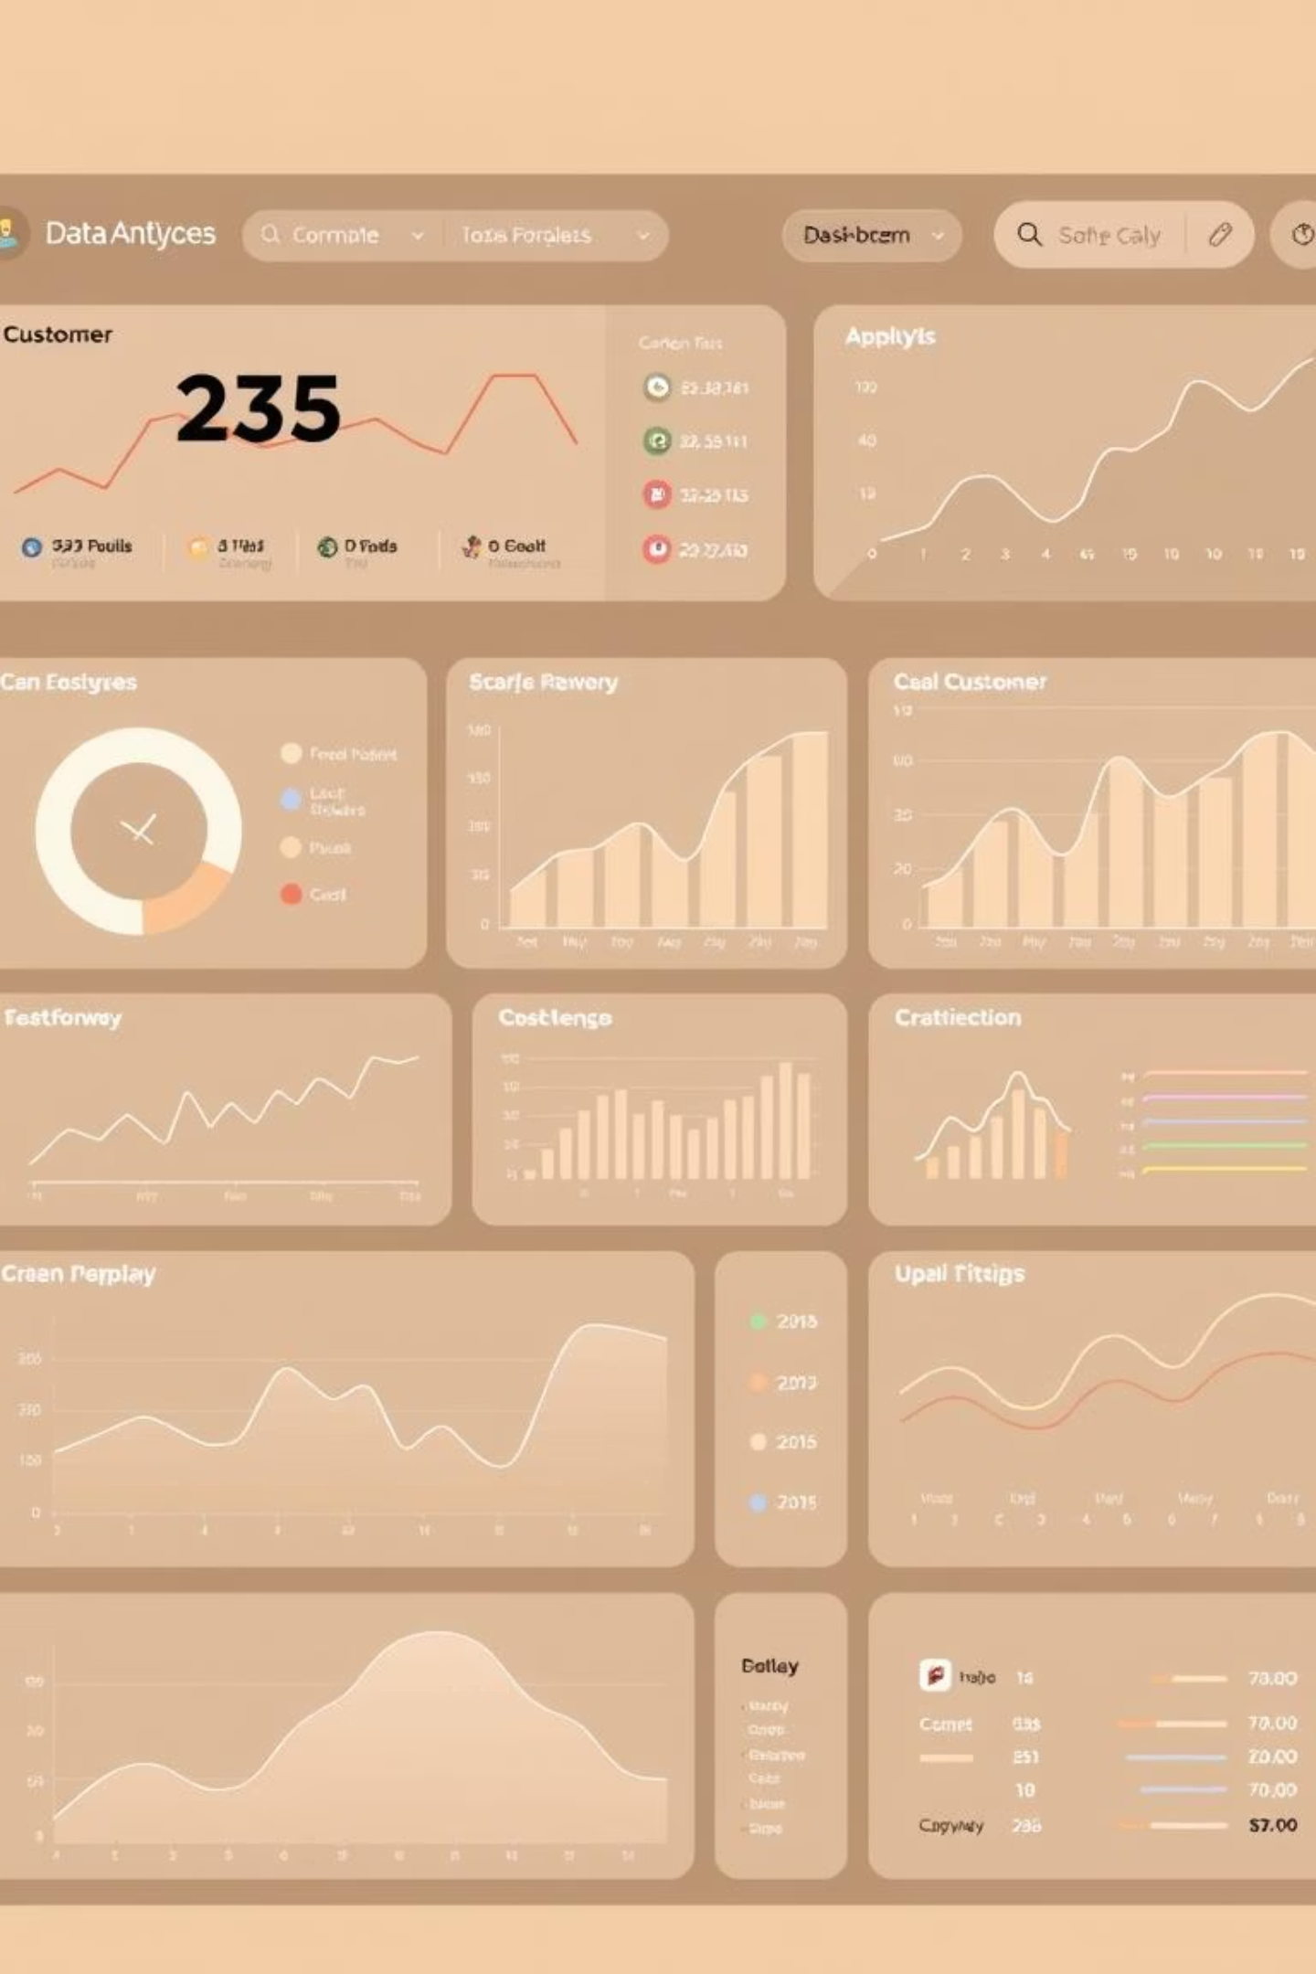
Phase 2: EDA & Feature Engineering
Done by Fares Waleed Badawi and Omar Grawani
Explore Churn Patterns
Deep dive into customer behavior related to tenure, contract length, and billing cycles to uncover correlations with churn.
Create Predictive Features
Develop new features from raw data that enhance the model's ability to predict churn, such as customer lifetime value or service usage changes.

Slide 9



Phase 3: Model Training & Validation
Done by Malak Alaa
Logistic Regression
Random Forest
Gradient Boosting
A foundational model for binary classification, providing interpretable insights into churn drivers.
An ensemble method that builds multiple decision trees to improve prediction accuracy and handle complex relationships.
A powerful technique that iteratively combines weak learners to create a strong predictive model.
We will rigorously evaluate models using ROC-AUC, precision, recall, and F1-score, ensuring robust performance and addressing class imbalance.

Slide 10

Phase 4: Deployment
Done by Mazen Mohamed and Fares Emad
The best-performing model will be seamlessly integrated into a simple, intuitive frontend. This allows business teams to gain real-time insights and test potential customer scenarios.
Ready to Retain Our Customers?

